Slide 1
SOLID PRINCIPLE
Robert C. Martin (Uncle Bob)

Slide 2
What are SOLID Principle?
SOLID is an acronym that stands for 5 design principles.
S — Single Responsibility Principle (SRP)
O — Open/Closed Principle (OCP)
L — Liskov Substitution Principle (LSP)
I — Interface Segregation Principle (ISP)
D — Dependency Inversion Principle (DIP)

Slide 3
Symptoms of Bad Code.
Code Rigidity Code that has dependencies in so many directions that you can’t make a change in isolation. You change one part of the code and it breaks the calling/dependant class and you have to fix it there. In the end, because of that one change, you end up making changes in 10 different classes.
Code Fragility When you make a change and an unrelated piece of code breaks.
Tight Coupling It happens when a class depends on another class.

Slide 4
Why we need SOLID Principle?
The simplest answer is the bad code. Which again lead to slow down the production.
As Uncle Bob, Robert C. Martin says
You don’t go fast by rushing.
You don’t go fast by just making it work and releasing it as fast as you can.
You wanna go fast? You do a good job.
You sit carefully, think about the problem, type a little, clean it up and repeat. That’s how you go fast.

Slide 5
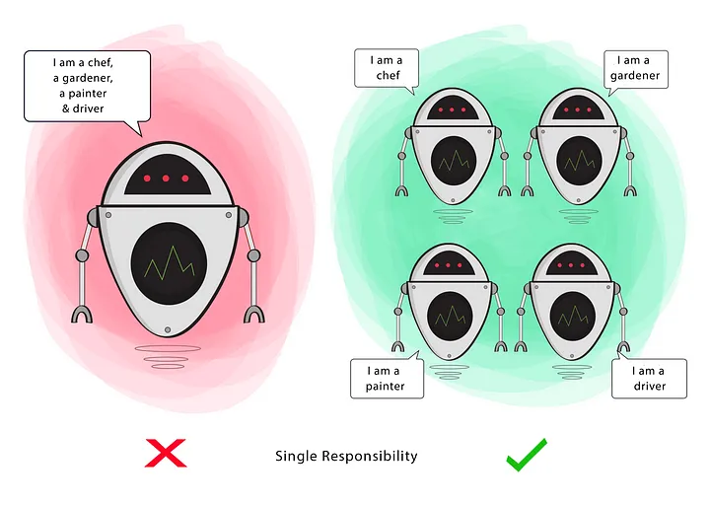
Single Responsibility Principle - (SRP)
~ a module should have only one reason to change.

Slide 6
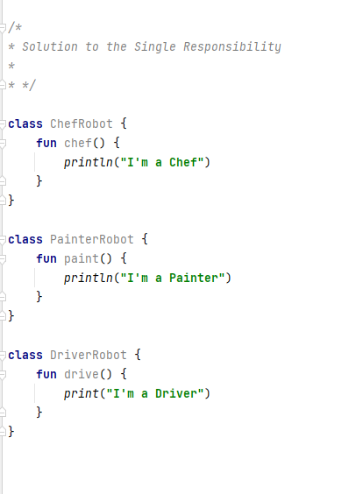
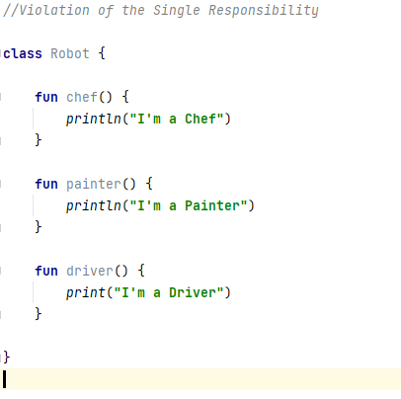

Slide 7
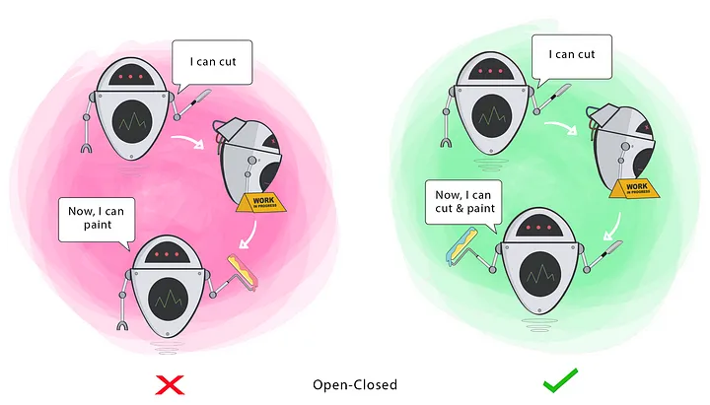
Open/Closed Principle - (OCP)
Classes should be open for extension, but closed for modification
Notes:
Write Notes

Slide 8
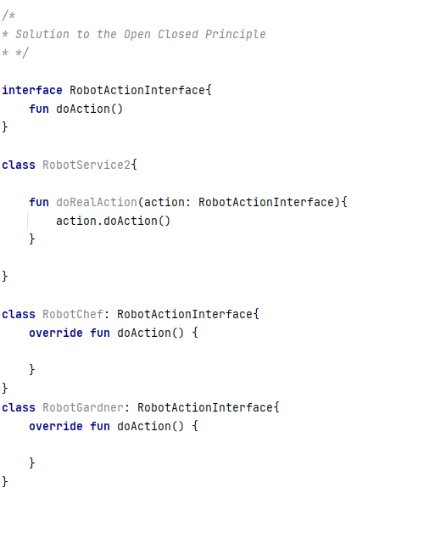
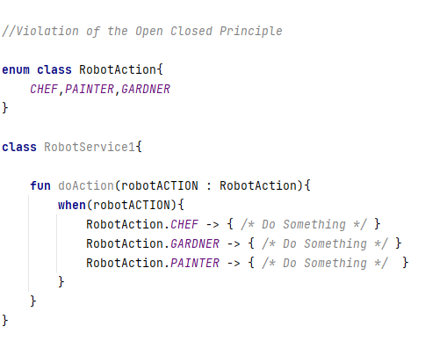

Slide 9
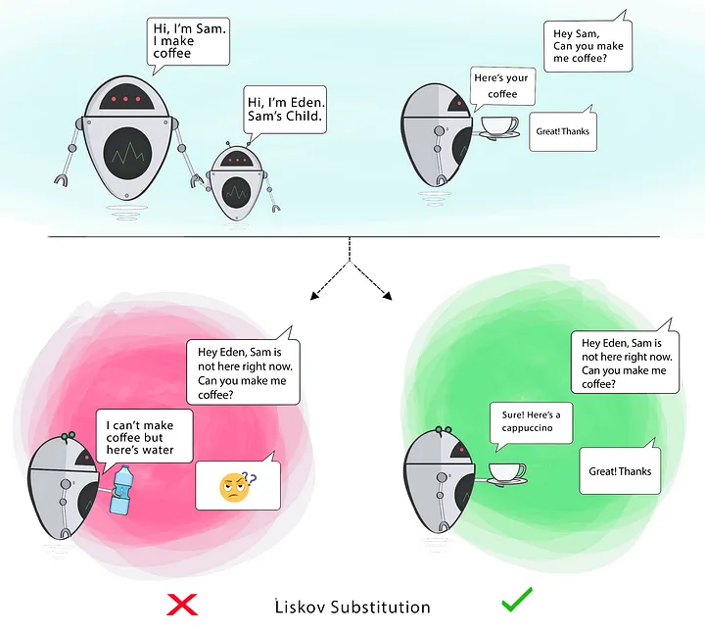
Liskov Substitution Principle - (LSP)
If S is a subtype of T, then objects of type T in a program may be replaced with objects of type S without altering any of the desirable properties of that program.

Slide 10
Violation of Liskov Substitution Principle
open class Rectangle {
private var height = 0
private var width = 0
open fun setHeight(height: Int) {
this.height = height
}
open fun setWidth(width: Int) {
this.width = width
}
fun area(): Int {
return height * width
}
}
class Square : Rectangle() {
override fun setHeight(height: Int) {
setSide(height)
}
override fun setWidth(width: Int) {
setSide(width)
}
private fun setSide(side: Int) {
super.setHeight(side)
super.setWidth(side)
}
}
fun main() {
val rectangle = Rectangle()
rectangle.setHeight(5)
rectangle.setWidth(2)
val rectangleCheck = rectangle.area() == 10 // true
val square: Rectangle = Square()
square.setHeight(5) square.setWidth(2)
val squareCheck = square.area() == 10 // false - not substitutable
}

Slide 11
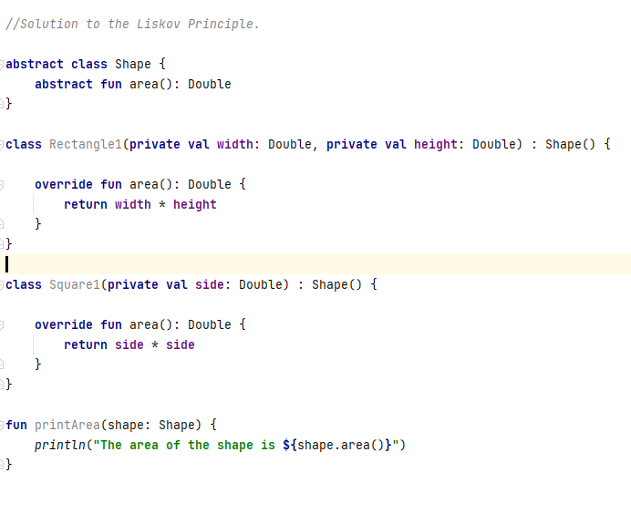
Solution:

Slide 12
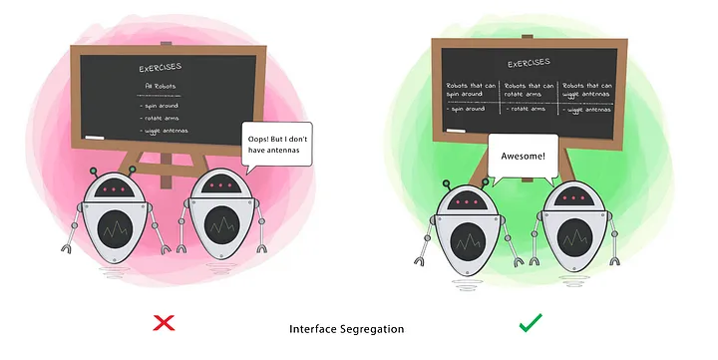
Interface Segregation Principle - (ISP)
Clients should not be forced to depend on methods that they do not use.

Slide 13
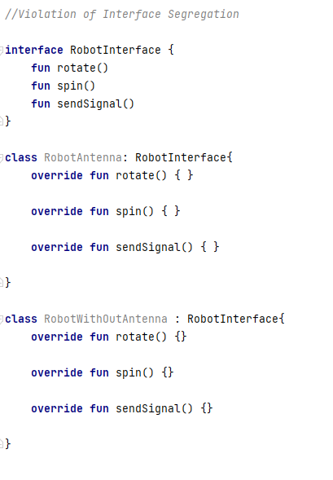
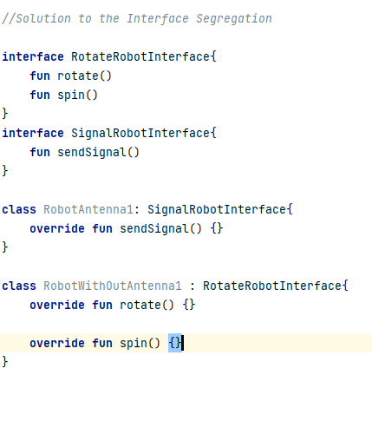

Slide 14
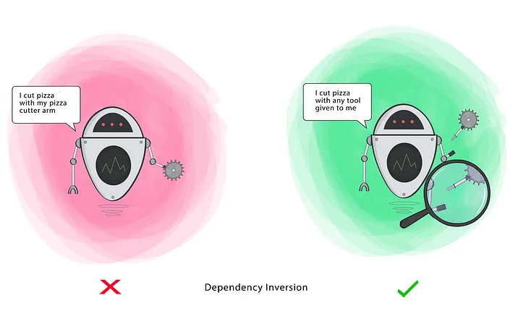
Dependency Inversion Principle - (ISP)
High-level modules should not depend on low-level modules. Both should depend on the abstraction.
Abstractions should not depend on details. Details should depend on abstractions.

Slide 15
